Slide 1
Chapter 4
Nairobi Smart Parking system
SYSTEM IMPLEMENTATION AND TESTING CONCLUSION AND RECOMMENDATION
JOB MOGIRE
SCT222-0163/2021

Slide 2
Introduction
This chapter details the journey of transforming the Smart Parking System design into a working application using Next.js.
We will explore the implementation process, highlighting the environment, tools, and key components developed.
It concludes with findings, general conclusions, and recommendations for future enhancements in scalability, security, and usability.

Slide 3
Implementation
The Smart Parking System was implemented using a modern web development stack centered around Next.js
Tools Used: Frontend Framework:
Next.js: User interface, Server-Side Rendering (SSR), API routes, optimized page loading.
Tailwind CSS: Fast, utility-first styling and responsive design.
Backend Services:
Next.js API Routes: Handling user authentication, booking management, and real-time slot availability.
Convex Database: Globally distributed, reactive database.
Authentication and Security:
NextAuth.js: Secure user authentication and session management.
Development Tools:
Visual Studio Code (VS Code): Primary code editor.
Git and GitHub: Version control and collaborative development.
Postman: Testing APIs during backend development.
Hosting/Deployment:
Locally on web browser.

Slide 4
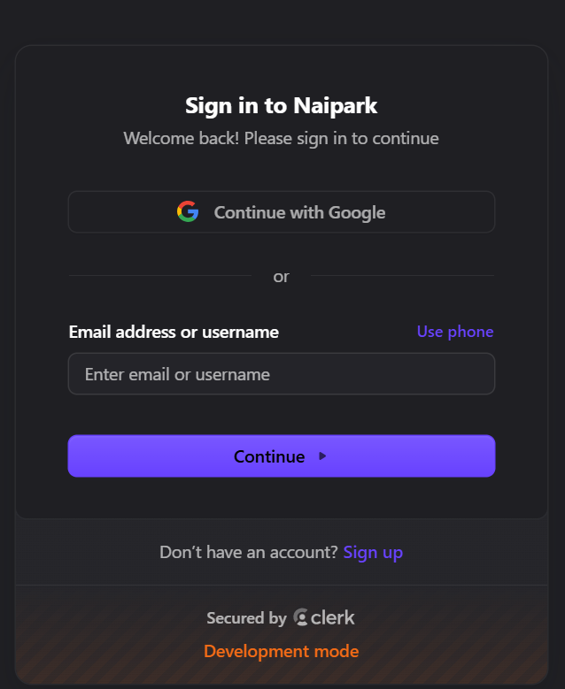
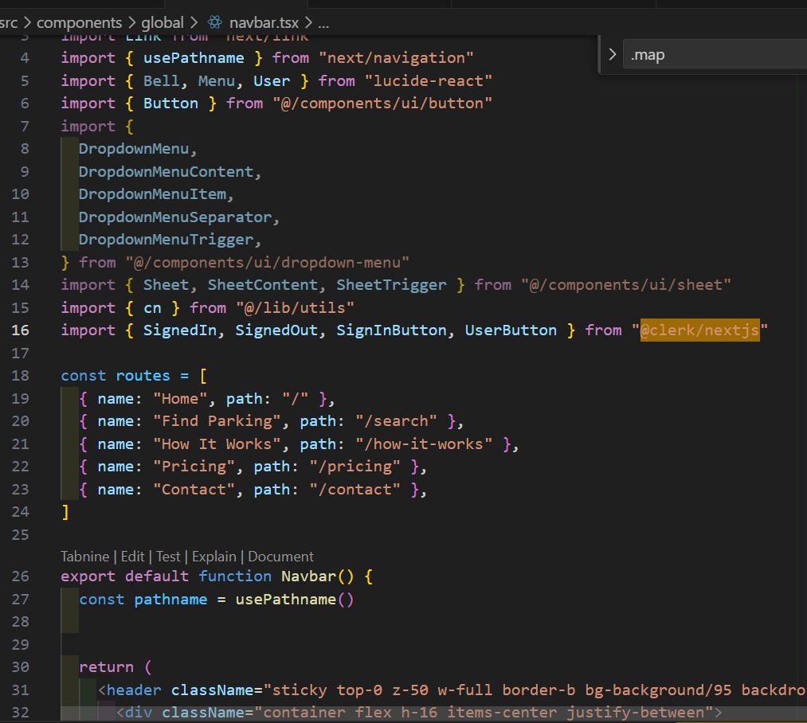
Pages and code snippets
Login/Registration page

Slide 5
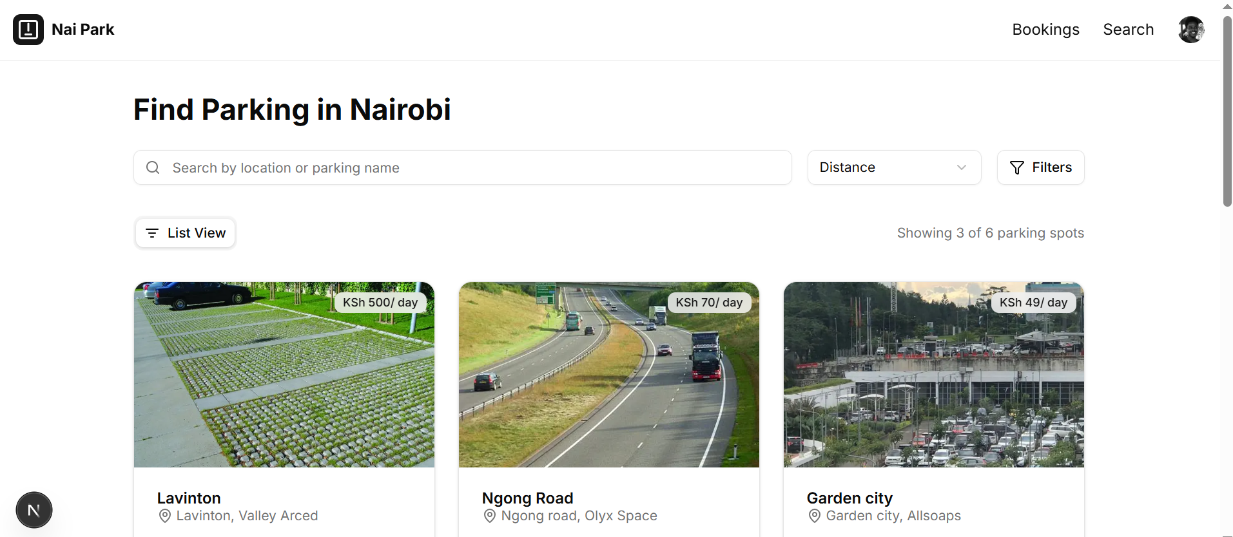
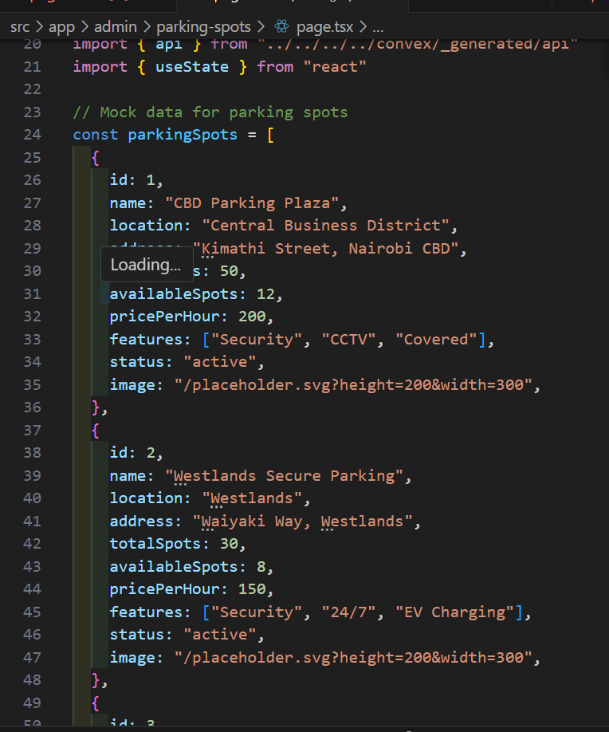
Find parking page

Slide 6
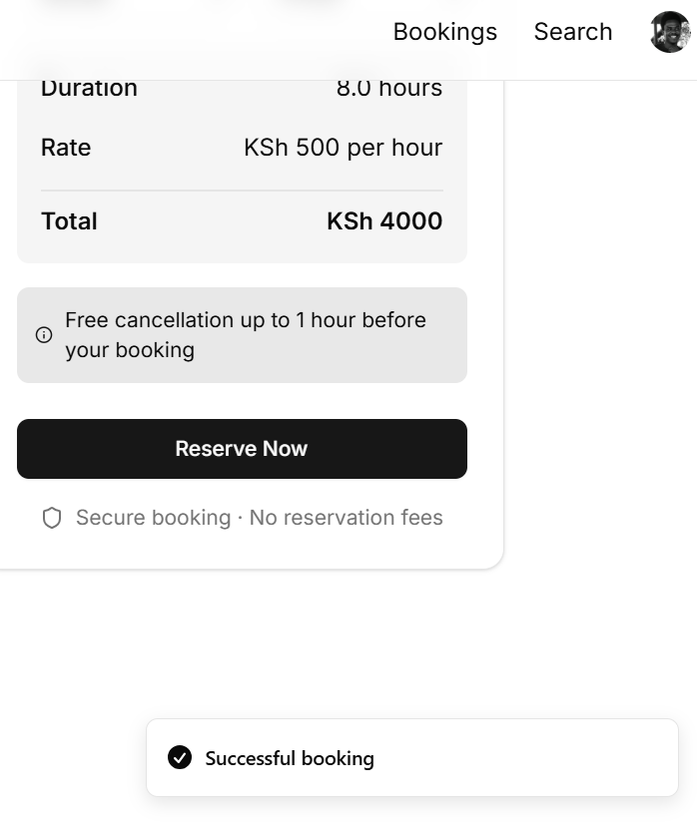
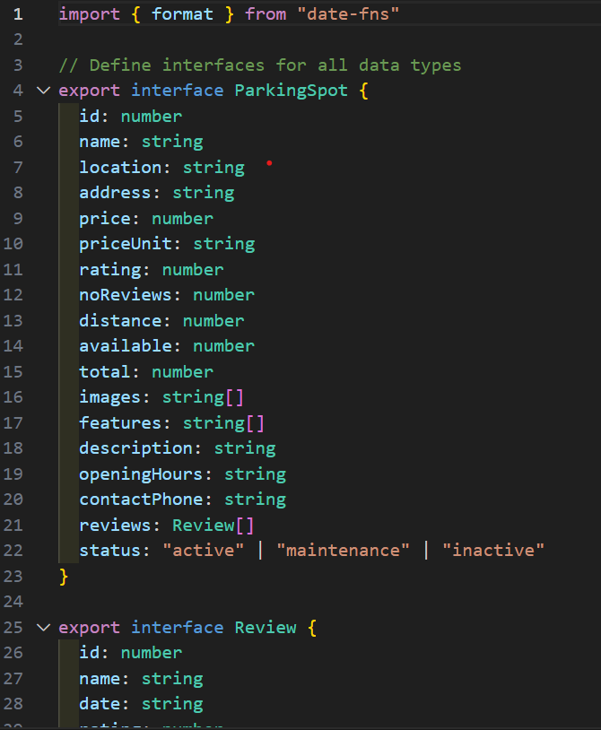
Reservation page

Slide 7
Testing
Tested Endpoints:
Login: POST /api/auth/login – Authenticates user
Available Slots: GET /api/slots/available – Returns free slots
Booking: POST /api/bookings – Confirms reservation
Payment: POST /api/payments – Processes transaction
Result: All endpoints responded with correct data and status codes (200/201), confirming system reliability and integration success.

Slide 8
Strengths
Benefits for All
For Drivers:
Less search time & frustration
Increased convenience (booking, payments, navigation)
Clear pricing
For Parking Operators:
Increased revenue (dynamic pricing, reduced unpaid)
Optimized space use
Lower operational costs (automation)
For Environment & Society:
Reduced traffic congestion
Lower emissions

Slide 9
Limitations
Challenges Encountered
Costly Hardware: Physical sensors for real-time detection can be expensive.
Scalability Issues: Expanding infrastructure and managing more sensors is complex and costly.
Internet Dependency: System relies on stable internet for real-time updates.

Slide 10
Recommendations
Enhancing the Smart Parking System
Offline Capabilities: Implement offline mode with cached data for areas with poor connectivity.
Wider IoT Sensor Integration: Explore cost-effective sensors for broader real-time data coverage.
Predictive Parking Availability: Use data analytics to forecast availability and aid user planning.
Enhanced Security: Strengthen protocols with MFA and updated data protection measures.
Payment Flexibility: Integrate more payment options (digital wallets, crypto, mobile) and consider a loyalty program.
Expanded Admin Reporting: Provide detailed usage, revenue, and occupancy reports with remote monitoring.
Broader Urban Integration: Develop modular architecture for integration with city traffic and public transport systems.

Slide 11
Conclusion
Smart Parking: Modernizing the Parking Ecosystem
Integrates sensors, networks, software, and user interfaces for real-time parking information.
Benefits for drivers: Reduced search time, fuel use, and congestion.
Benefits for operators: Dynamic pricing, automated payments, enhanced security, and data insights.
Aims for a more efficient, convenient, and sustainable parking experience.
Leads to increased operator revenue, improved driver satisfaction, and positive urban/environmental impact.

